Slide 1
DAY 7 PPT

Slide 2
Variables/Data types
A variable is nothing but a name given to a storage area that our programs can manipulate.
Each variable in C has a specific type, which determines the size and layout of the variable's memory; the range of values that can be stored within that memory; and the set of operations that can be applied to the variable.
The name of a variable can be composed of letters, digits, and the underscore character.
It must begin with either a letter or an underscore. Upper and lowercase letters are distinct because C is case-sensitive, there will be the following basic variable types:
Char Typically a single octet (one byte). This is an integer type. Int The most natural size of integer for the machine. Float A single-precision floating point value. Double A double-precision floating point value. Void Represents the absence of type.

Slide 3
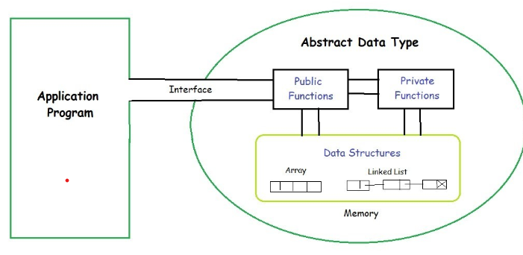
Abstract Data types
Abstract Data type (ADT) is a type (or class) for objects whose behavior is defined by a set of values and a set of operations.
The definition of ADT only mentions what operations are to be performed but not how these operations will be implemented. It does not specify how data will be organized in memory and what algorithms will be used for implementing the operations. It is called “abstract” because it gives an implementation-independent view.
The process of providing only the essentials and hiding the details is known as abstraction.

Slide 4
Why ADT?
Hide the unnecessary details
Help manage software complexity
Easier software maintenance
Functionalities are less likely to change
Localised rather than global changes

Slide 5
Data structures
Arrays allow to define type of variables that can hold several data items of the same kind. Similarly, structure is another user-defined data type available in C that allows to combine data items of different kinds.
Structures are used to represent a record. Suppose you want to keep track of your books in a library. You might want to track the following attributes about each book:
Title
Author
Subject
Book ID
Defining a Structure
To define a structure, you must use the struct statement. The struct statement defines a new data type, with more than one member. The format of the struct statement is as follows:
struct [structure tag]{
member definition;
member definition;
member definition;
} [one or more structure variables);
The structure tag is optional and each member definition is a normal variable definition, such as int i; or float f; or any other valid variable definition. At the end of the structure's definition, before the final semicolon, you can specify one or more structure variables but it is optional. Here is the way you would declare the Book structure:

Slide 6
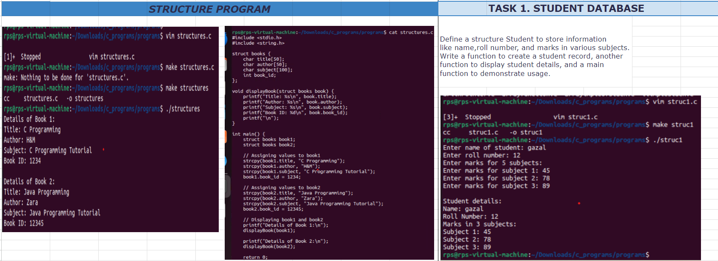
Structure Example

Slide 7
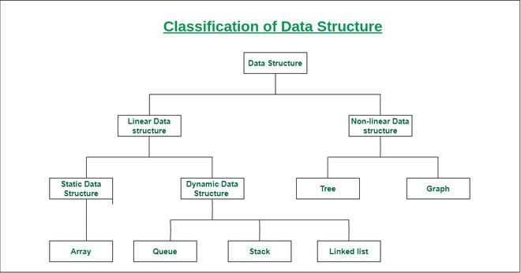
Data Structures Classifications

Slide 8
What is queue?
Queue is a linear data structure that follows a particular order in which the operations are performed for storing data.
The order is First In First Out (FIFO).
One can imagine a queue as a line of people waiting to receive something in sequential order which starts from the beginning of the line. It is an ordered list in which insertions are done at one end which is known as the rear and deletions are done from the other end known as the front. A good example of a queue is any queue of consumers for a resource where the consumer that came first is served first.
The difference between stacks and queues is in removing. In a stack we remove the item the most recently added; in a queue, we remove the item the least recently added.
Basic Operations on Queue:
enqueue(): Inserts an element at the end of the queue i.e. at the rear end.
dequeue(): This operation removes and returns an element that is at the front end of the queue.
front(): This operation returns the element at the front end without removing it.
rear(): This operation returns the element at the rear end without removing it.
isEmpty(): This operation indicates whether the queue is empty or not.
isFull(): This operation indicates whether the queue is full or not.
size(): This operation returns the size of the queue i.e. the total number of elements it contains.

Slide 9
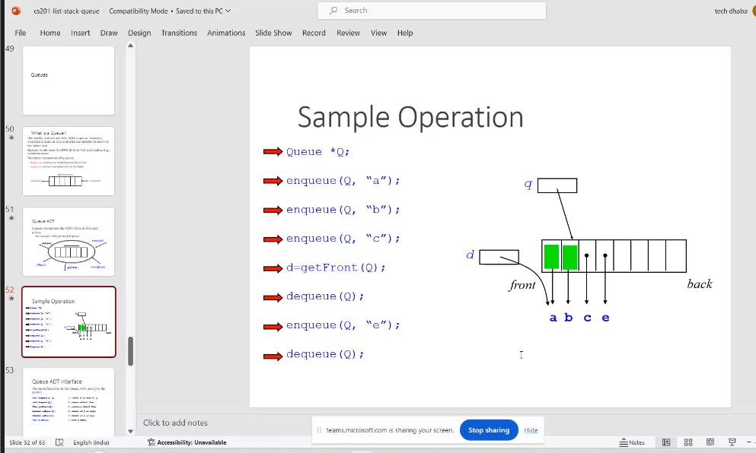
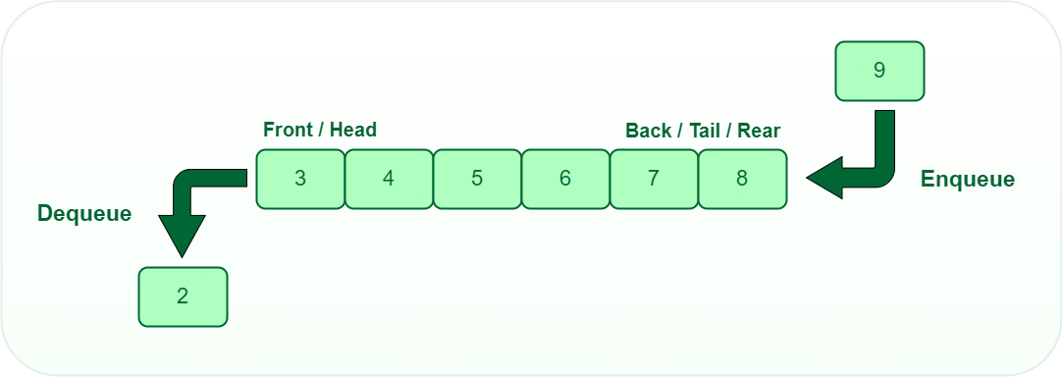
Implementation of queue

Slide 10
What is Stack?
Stack is a linear data structure that follows LIFO (Last In First Out) Principle , so the last element inserted is the first to be popped out. In this article, we will cover all the basics of Stack, Operations on Stack, its implementation, advantages, disadvantages which will help you solve all the problems based on Stack.
To implement the stack, it is required to maintain the pointer to the top of the stack , which is the last element to be inserted because we can access the elements only on the top of the stack.
LIFO(Last In First Out) Principle in Stack:
This strategy states that the element that is inserted last will come out first.
You can take a pile of plates kept on top of each other as a real-life example.
The plate which we put last is on the top and since we remove the plate that is at the top, we can say that the plate that was put last comes out first.
Basic Operations on Stack:
In order to make manipulations in a stack, there are certain operations provided to us.
push() to insert an element into the stack
pop() to remove an element from the stack
top() Returns the top element of the stack.
isEmpty() returns true if stack is empty else false.
isFull() returns true if the stack is full else false.

Slide 11
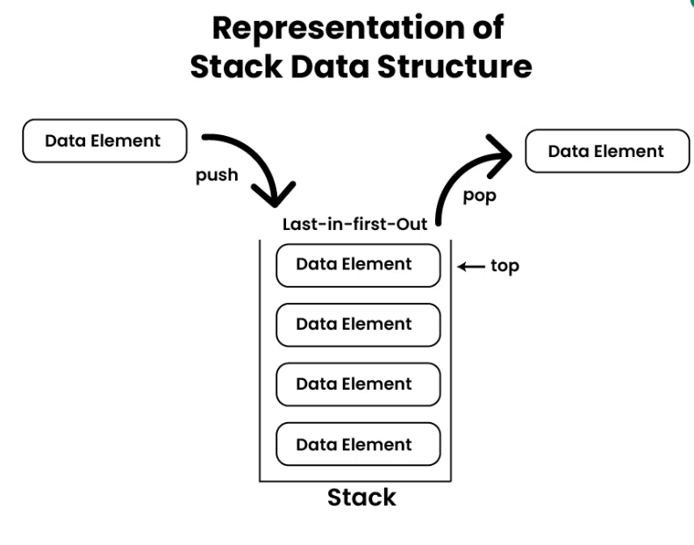
Representation of stack

Slide 12
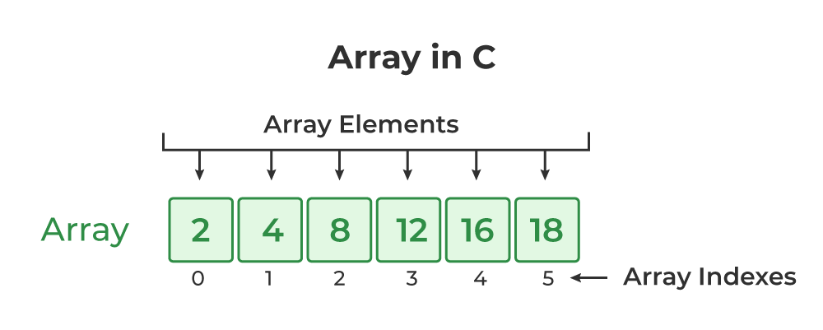
Array Data Structure
An array data structure is a fundamental concept in computer science that stores a collection of elements in a contiguous block of memory. It allows for efficient access to elements using indices and is widely used in programming for organizing and manipulating data.
Array Operations
Common operations performed on arrays include:
Traversal: Visiting each element of an array in a specific order (e.g., sequential, reverse).
Insertion: Adding a new element to an array at a specific index.
Deletion: Removing an element from an array at a specific index.
Searching: Finding the index of an element in an array.

Slide 13
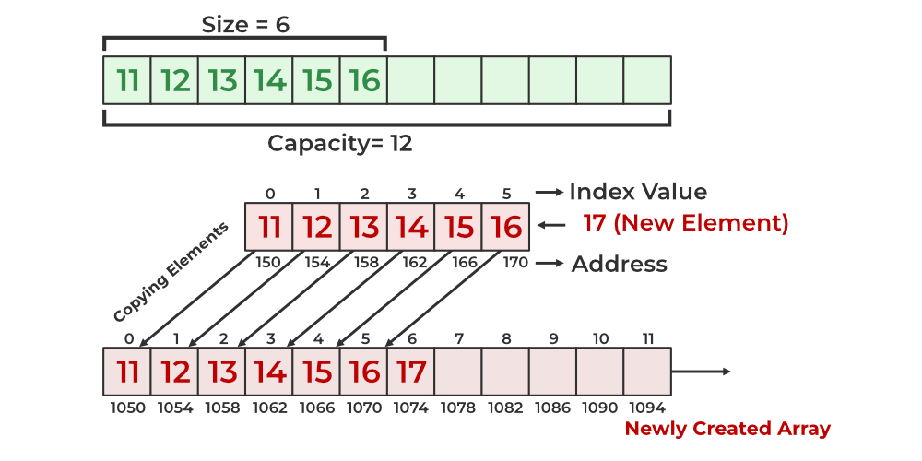
Insertion in array representation

